Slide 1


YOUTUBE
Data Analysis 2022
Celebrating the statistics on YouTube is a start, but true social presence is measured in the meaningful connections, conversations, and communities you build through your content.
Presented By : Vaibhav Sirohi
NIIT : DA92S9 Batch-2023
Notes:
Creadit picture : Unsplash Photo by Chris Yang
Link : https://unsplash.com/photos/1BtAeOohu1A Photo by Vidar Nordli-Mathisen
Link : https://unsplash.com/photos/xqMM3KoR7oI

Slide 2


LET START WITH YOUR PRESENTATION
In today's digital world, YouTube and internet content creation are incredibly fascinating. I used data from Kaggle to find out what people really like to watch on YouTube. I looked at things like popular categories and how viewers engage with videos. This exploration helps us understand what grabs our attention when we're online.
Data Set : Global YouTube Statistics 2023 (kaggle.com)

Slide 3

Business Objective Goal
The business objective is to gain insights from the available data related to YouTube channels, their earnings, world wide engagement metrics by view, video rank , ranking and subscriber counts.
By analyzing this data, we aim to understand the performance of YouTube channels and categories, identify top performers and recognize trends across different countries and categories on the platform.
These insights can inform Content Creators , Marketing Agencies and businesses on how to optimize their strategies for YouTube success and for the better understand their audience and tailor their content effectively, so that they can market/advertise there product and services.

Slide 4


Table of Content
EDA: YouTube Data Analysis
Analyzing on different criteria.
Analysis on categorical and continuous aspects based on different criteria.
What are the top 10 YouTube channels with the highest yearly/ monthly earnings?
Top 10 YouTube channels with respect to ranking/country ranking and their earnings ,views ,subscription?
Top 10 categories on YouTube with respect to ranking/country ranking and their earnings, views ,subscription?
What are the top 10 countries with the highest YouTube subscription counts?
Can we identify the top 10 YouTube channels by subscription count along with their respective countries?
What are the top 10 YouTube channels with the highest yearly earnings in each country?
Who are the top 10 highest-earning YouTube channels in India in terms of yearly earnings?
Which YouTube channel has the highest video views in India?
How do subscribers and earnings vary across different YouTube categories in India?
What are the category-wise subscriber counts on YouTube in India?
How do total video views vary across different YouTube categories in India?
Can we identify the category with the lowest monthly earnings on YouTube in India?
DASHBOARD FOR YOUTUBE DATA ANALYSIS

Slide 5
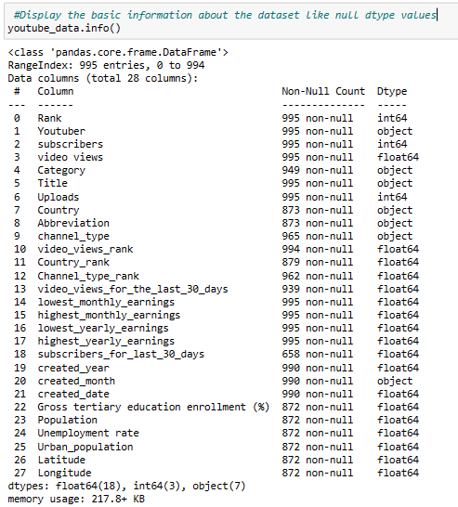
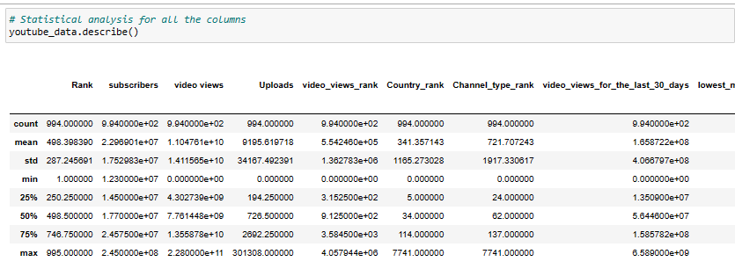
YOUTUBE CHANNEL INSIGHTS RELATED TO DIFFERENT CRITERIA USING PYTHON ANALYSIS
DATA CLEANING AND PRE PROCESSING
Display the basic information about the dataset like null d-type values
Statistical analysis

Slide 6
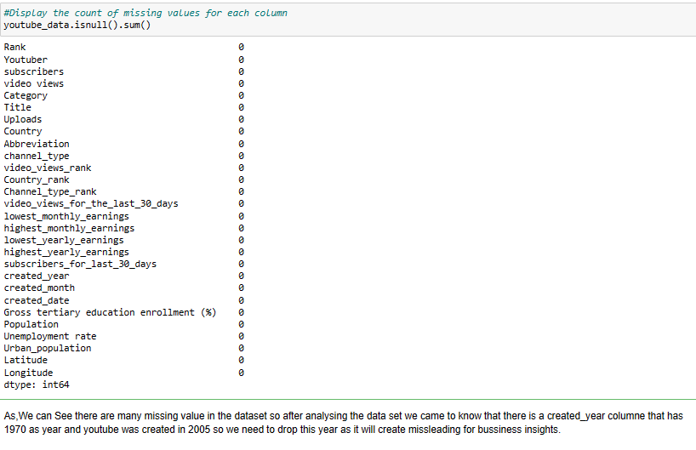
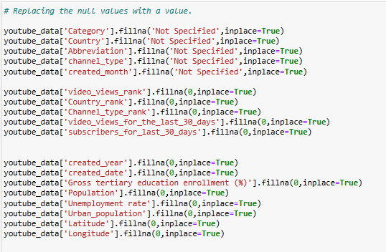
YOUTUBE CHANNEL INSIGHTS RELATED TO DIFFERENT CRITERIA USING PYTHON ANALYSIS
DATA CLEANING AND PRE PROCESSING
Display the basic information about the dataset like null d-type values
Count of missing values for each column
Replacing the null values with a value.
Statistical analysis

Slide 7
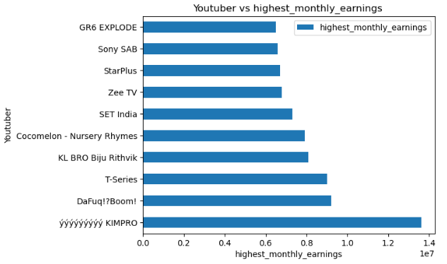

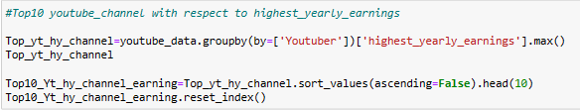
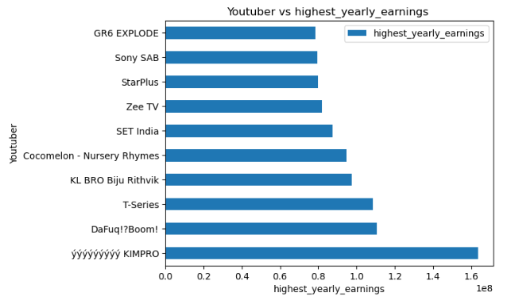
YOUTUBE CHANNEL INSIGHTS RELATED TO EARNING USING PYTHON ANALYSIS
Highest Monthly/yearly earning from channel
South Korea YT Channel ýýýýýýýýýýýýýýýý KIMPRO has highest earning in year 2022 was $163 Million.
Monthly Earnings: You can create a ranking based on a channel's earnings, with the highest earners ranking higher.
Yearly Earnings: Similar to monthly earnings, but considering the channel's annual income.

Slide 8
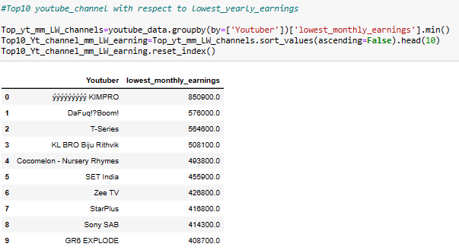
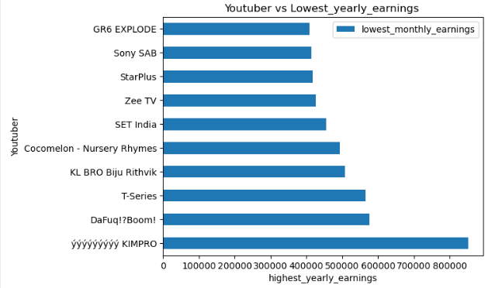
YOUTUBE CHANNEL INSIGHTS RELATED TO EARNING USING PYTHON ANALYSIS
Similarly for the Lowest yearly earning from channel
YouTube channel yyyyyyyyyy KIMPRO has the lowest monthly Earning worldwide.

Slide 9
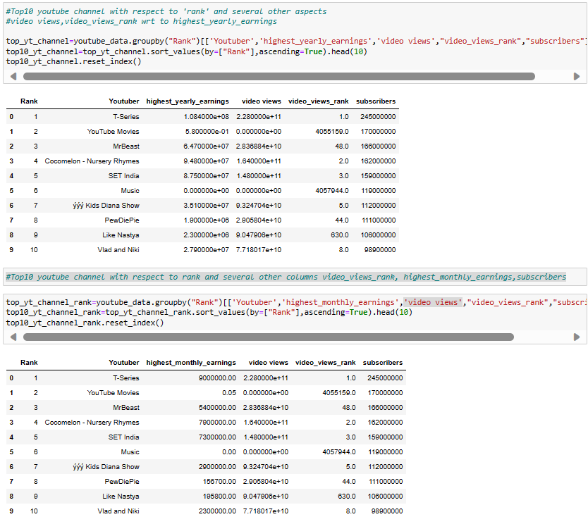
YOUTUBE CHANNEL INSIGHTS RELATED TO WORLD RANKING, MM/YY EARNING Subscribers, Video Views/RANK USING PYTHON ANALYSIS
Top10 YouTube channel with respect to ‘Rank' and several other aspects.
T-series has the highest values w.r.t to below criteria (followed by other channels)
Ranking
Earning(MM/YY)
Subscribers
Video Views
Video Views RANK

Slide 10
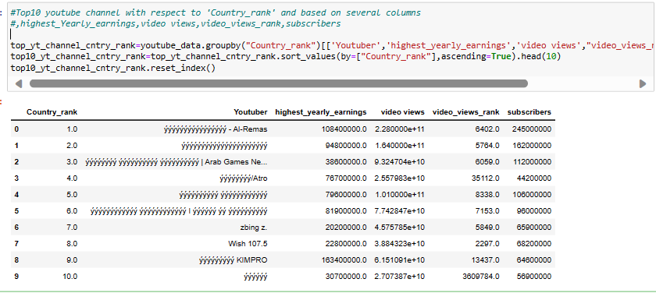
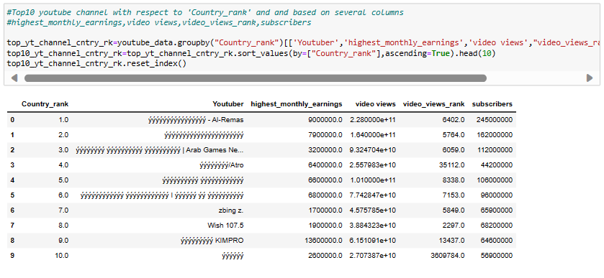
YOUTUBE CHANNEL INSIGHTS RELATED TO GLOBAL COUNTRY RANKING, EARNING,SUBSCRIBER,VIDEO_VIEW/RANK USING PYTHON ANALYSIS
Top10 YouTube channel with respect to ‘Country Rank' and several other aspects.
ýýýýýýýýýýýýýýýý - Al-Remas has the highest values w.r.t to below criteria (followed by other channels) .
Ranking
Earning (MM/YY)
Subscribers
Video Views
Video Views RANK

Slide 11
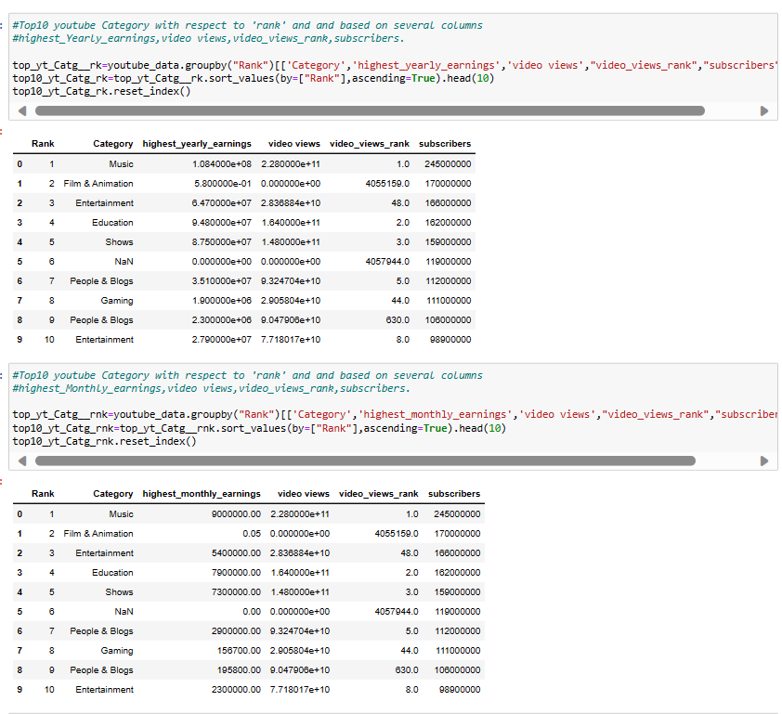
CATEGORY-WISE CHANNEL INSIGHTS RELATED TO GLOBAL COUNTRY RANKING, EARNING ,SUBSCRIBER,VIDEO_VIEW/RANK USING PYTHON ANALYSIS
Top10 CATEGORY-WISE channel with respect to ‘Rank' and several other aspects.
MUSIC - Category has the highest values w.r.t to below criteria (followed by other channels categories) .
Ranking
Earning (MM/YY )
Subscribers
Video Views
Video Views RANK

Slide 12

YOUTUBE CHANNEL INSIGHTSUSING DATA TOOL : TABLEAU
Analysis YouTube Dataset on different criteria using Tableau with several insights requirements.
Earnings
Top 10 YouTube channels with: Highest yearly earnings and monthly earning.
Identify the category with the lowest monthly earnings on YouTube in India?
Top 10 YouTube channels with the highest yearly earnings in each country?
Video Engagement
Top 10 categories on YouTube with respect to subscribers and their highest yearly earnings and views?
Which YouTube channel has the highest video views in India?
Total video views vary across different YouTube categories in India?
Subscriber Engagement & Global Trends
What are the top 10 countries with the highest YouTube subscription counts?
Top 10 YouTube channels by subscription count along with their respective countries?
What are the category-wise subscriber counts on YouTube in India?

Slide 13
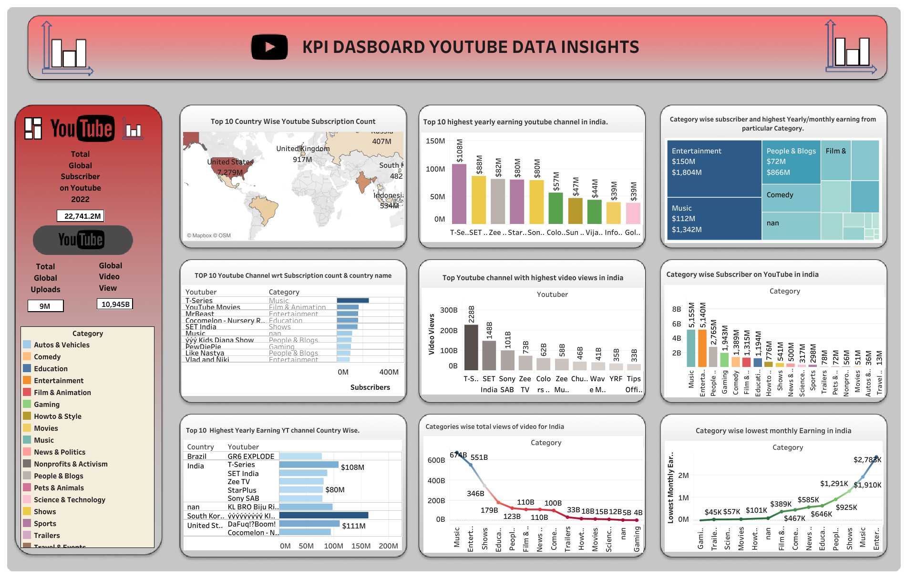


Slide 14
YOUTUBE CHANNEL INSIGHTS RELATED TO Global, Domestic CRITERIA
Global insights
USA has the most no of subscriber counts : 7279 Million
YouTube channel T-Series has most no of subscriber count worldwide: 245 Million
South Korea YT Channel ýýýýýýýýýýýýýýýý KIMPRO has highest earning in year 2022 was $163 Million.
YouTube categories like Music, Film and Animation ,Entertainment, Shows ,Education ,People & Blogs are among the High earned and ranked ,top viewed and subscribed channels by people.
YT Channel T-Series Ranked Among the top as Global ranking and among country ranking in terms of subscription, earning , Video viewed
Domestic Insights
T-series is among the highest earning YouTube channel $108 Million followed by SET India at $88 Million.
T-Series also among the most viewed channel with video view of 228 Billion views followed by Set India at 148 Billion views.
YouTube categories like Music, Entertainment ,Shows, Education ,People & Blogs are among the High earned and ranked, top viewed and subscribed channels by people.
YT Channel T-Series Ranked Among the top among country ranking in terms of subscription, earning , Video viewed.

Slide 15

Conclusion
So, As we discussed in our previous slide about all the insights that we extracted from the global data set of YouTube, that can be valuable for content creators, marketing Agencies and businesses looking to enhance their YouTube strategies that help them to market there product/services to the target audience and Region for business advertisement and branding.
For example, they can focus on
Top Popular categories, Global & Domestic Region wise channels.
learn from top-performing channels, Target countries with a significant YouTube user base to maximize their reach and engagement on the platform.
Additionally, understanding earnings and engagement metrics can help creators make data-driven decisions to optimize their content and monetization strategies

Slide 16
THANK
YOU
"YouTube is not just a platform; it's a global community where voices from all corners of the world come together, connect, and share their stories."
Presented By : Vaibhav Sirohi
NIIT : DA92S9 Batch-2023

